Slide 1
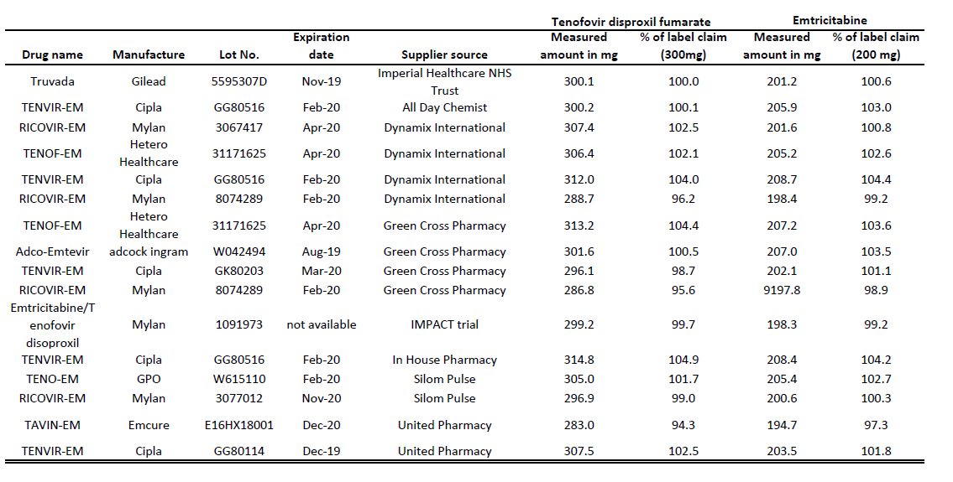
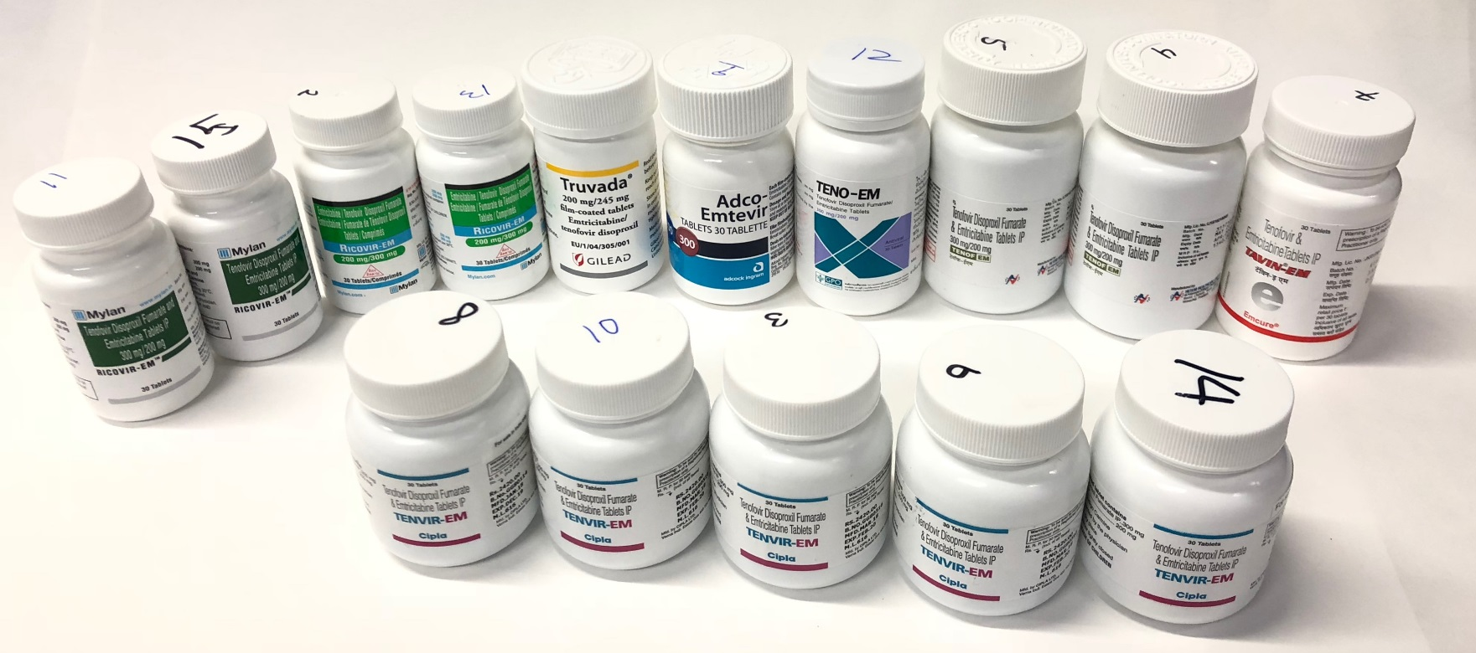
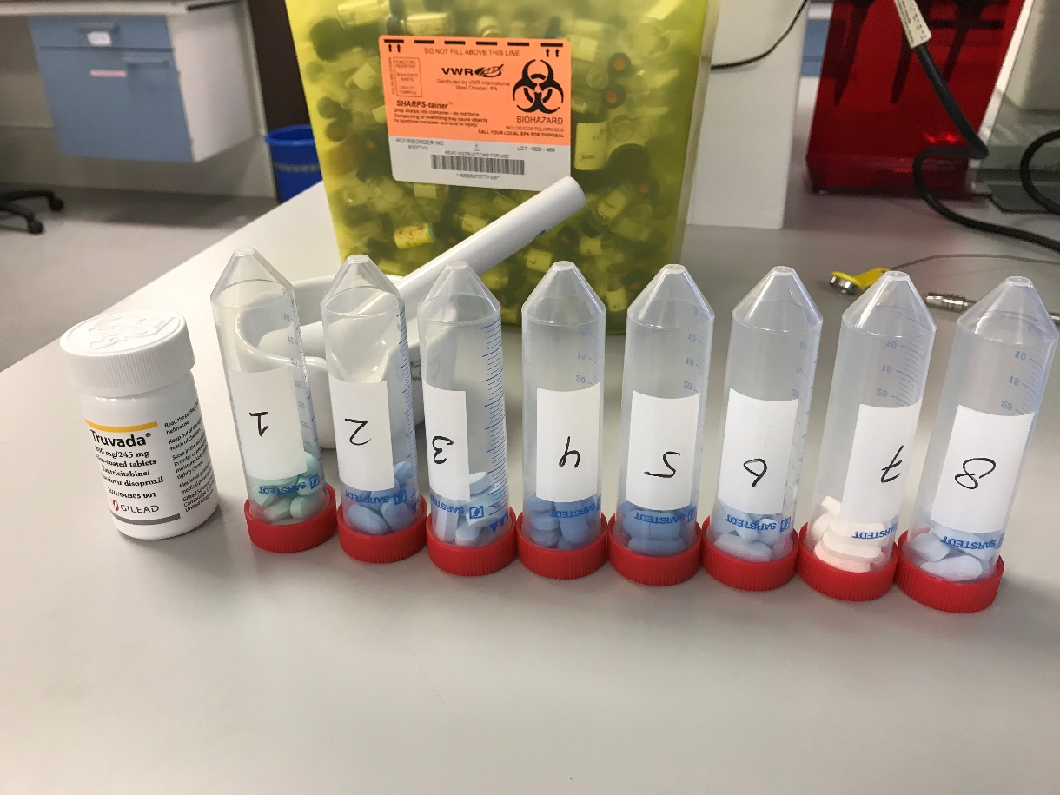
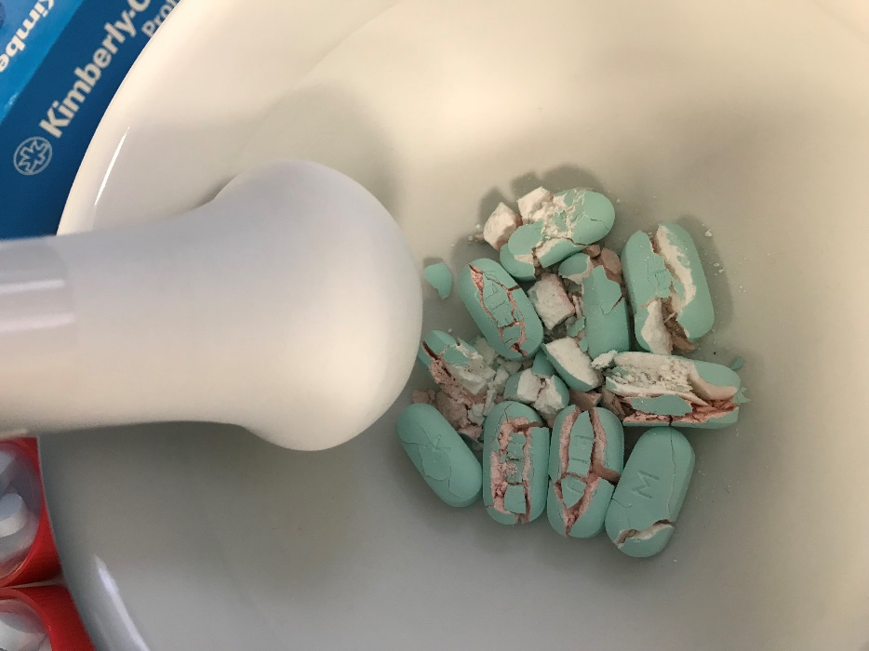
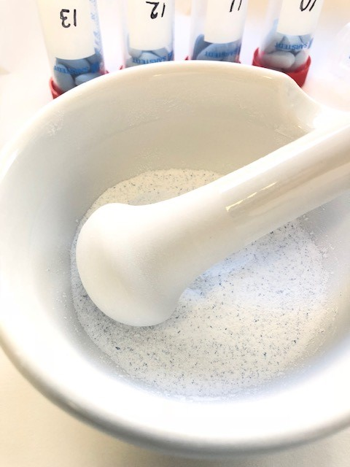
P010
Generic tenofovir disoproxil fumarate and emtricitabine tablets obtained from the internet – are they what they say they are?
Xinzhu Wang¹, Will Nutland², Michael Brady³, Ian Green³, Myra McClure¹, Marta Boffito^{1,4}
¹Imperial College London, London, UK ²PrEPster, London, UK ³Terrence Higgins Trust, UK
⁴Chelsea and Westminster Hospital, London, UK
Background
Table
Pre-exposure prophylaxis (PrEP) with tenofovir disoproxil fumarate (TDF)/emtricitabine (FTC) has been shown to reduce dramatically the risk of HIV acquisition¹⁻². However, the National Health Service (NHS) in England has declined to commission PrEP, leading high-risk individuals to purchase generic versions on-line. Our team at Imperial College London provided therapeutic drug monitoring for tenofovir (TFV) and FTC in 2016-2017 for 293 individuals taking generic PrEP and reported that plasma concentrations were all above the target values³. More recently, concerns have arisen over the authenticity of generic PrEP purchased online. In the present study, we sampled generic PrEP from mainstream brands and suppliers and measured TDF and FTC in the purchased tablet form.
Methods
Generic PrEP tablets in sealed bottles of different brands and from different suppliers were purchased from the internet through test purchases. Truvada for PrEP® from Gilead was purchased from Imperial College Healthcare NHS Trust. The brand and supplier of the generic PrEP samples were blinded from the researcher carrying out the analysis. The active pharmaceutical ingredient TDF and FTC was quantified using a fully validated ultra-performance liquid chromatography assay.
Characteristic of PrEP samples. Supplier source of the generic PrEP samples was listed in alphabetic order.
Figures
Results
A total of 14 samples were obtained for analysis, including TruvadaTM from Gilead, PrEP used in the IMPACT trial⁴ and 13 generic PrEP tablets obtained from Mylan, Cipla, Hetero Healthcare, Emcure, Adcock ingram and GPO (Figure).
The suppliers were Dynamix International, In House Pharmacy, Green Cross Pharmacy, United Pharmacy, All Day Chemist and Silom.
As summarised in the table, all the PrEP tablets contained 94.3% to 104.9% of the 300 mg of TDF claimed on the label and 97.3% to 104.4% of the 200 mg FTC claimed on the label.
Bottle package of all the PrEP samples analysed in the study
Blinded PrEP samples ready for processing
Truvada by Gilead
Ricovir-EM by Mylan
Conclusions
Adco-Emtevir by adcock ingram
Grinding PrEP tablets (from IMPACT trial) using Pestle & Mortar
All the PrEP tablets sampled in this study contained the stated amount of TDF and FTC. We were able to confirm the stated content of the PrEP tablets from various manufactures and suppliers. This study provides reassurance to the community purchasing generic PrEP online and is a good example of a close collaboration between academics, clinicians, HIV charities and PrEP advocates.
TENO-EM by GPO
TENOF-EM by Hetero Healthcare
TAVIN-EM by Emcure
References
TENVIR-EM by Cipla
McCormack et al. Pre-exposure prophylaxis to prevent the acquisition of HIV-1 infection (PROUD): effectiveness results from the pilot phase of a pragmatic open-label randomised trial. Lancet 2016; 387:53-60.
Molina et al. On-demand preexposure prophylaxis in men at high risk for HIV-1 infection. N Engl J Med 2015; 373:237-2246.
Wang et al. InterPrEP: Internet-based pre-exposure prophylaxis with generic tenofovir disproxil fumarate/emtricitabine in London – analysis of pharmacokinetics, safety and outcomes. HIV medicine 2018; 19,1-6.
https://www.prepimpacttrial.org.uk/
Fine powder ready to be dissolved in solvent

